Slide 1
Game of Thrones Application
IDP – Technical Evaluation 2

Slide 2
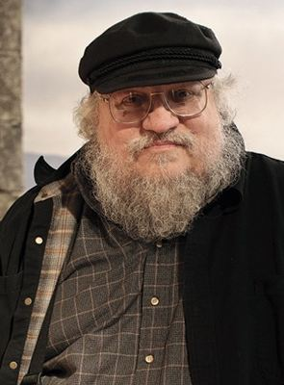

What is Game of Thrones?

Slide 3
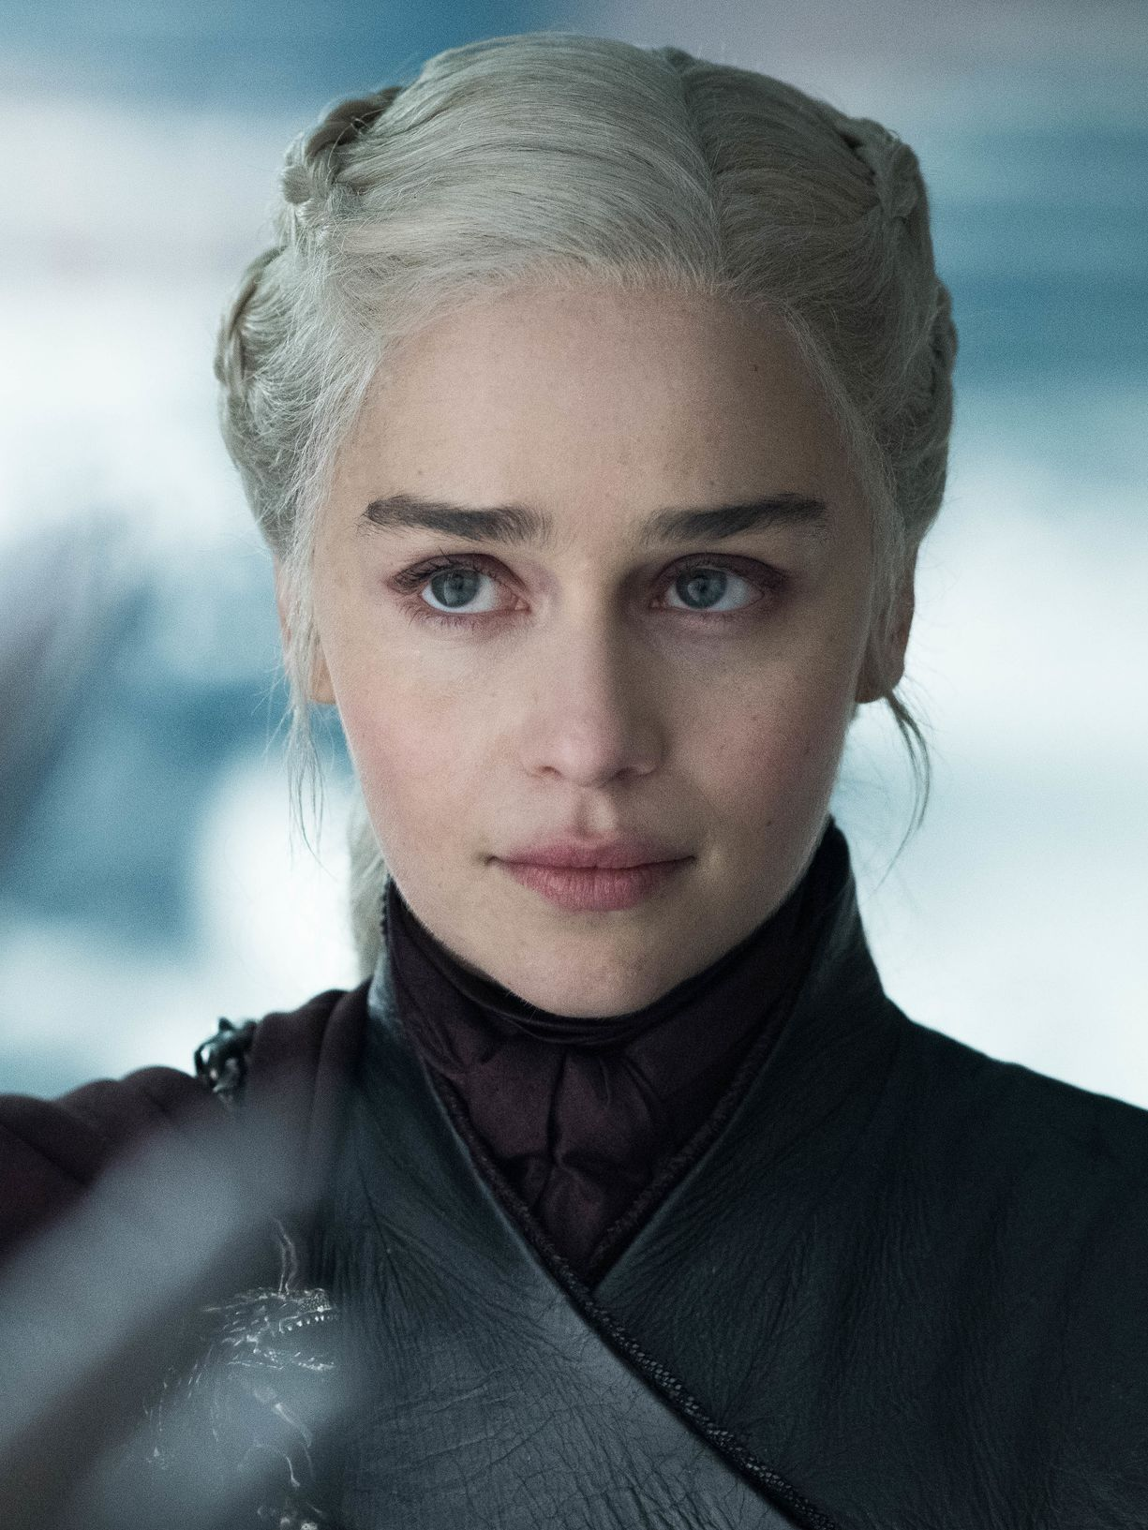
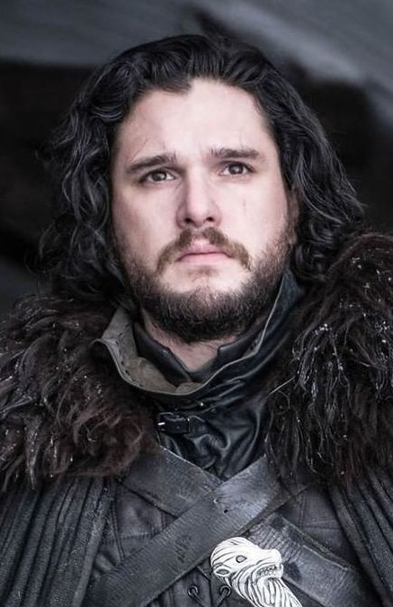
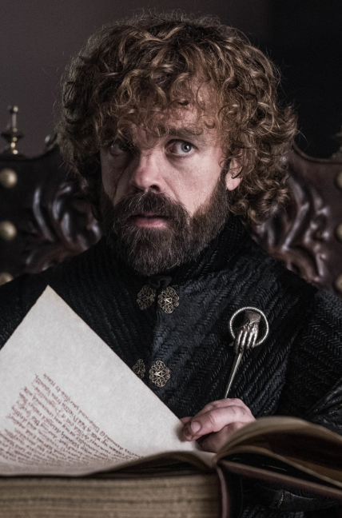
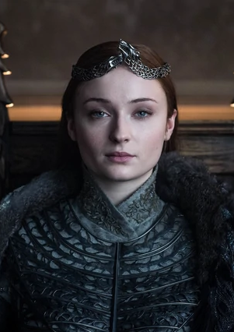
Characters
Daenerys Targaryen
Jon Snow
Tyrion Lannister
Sansa Stark

Slide 4
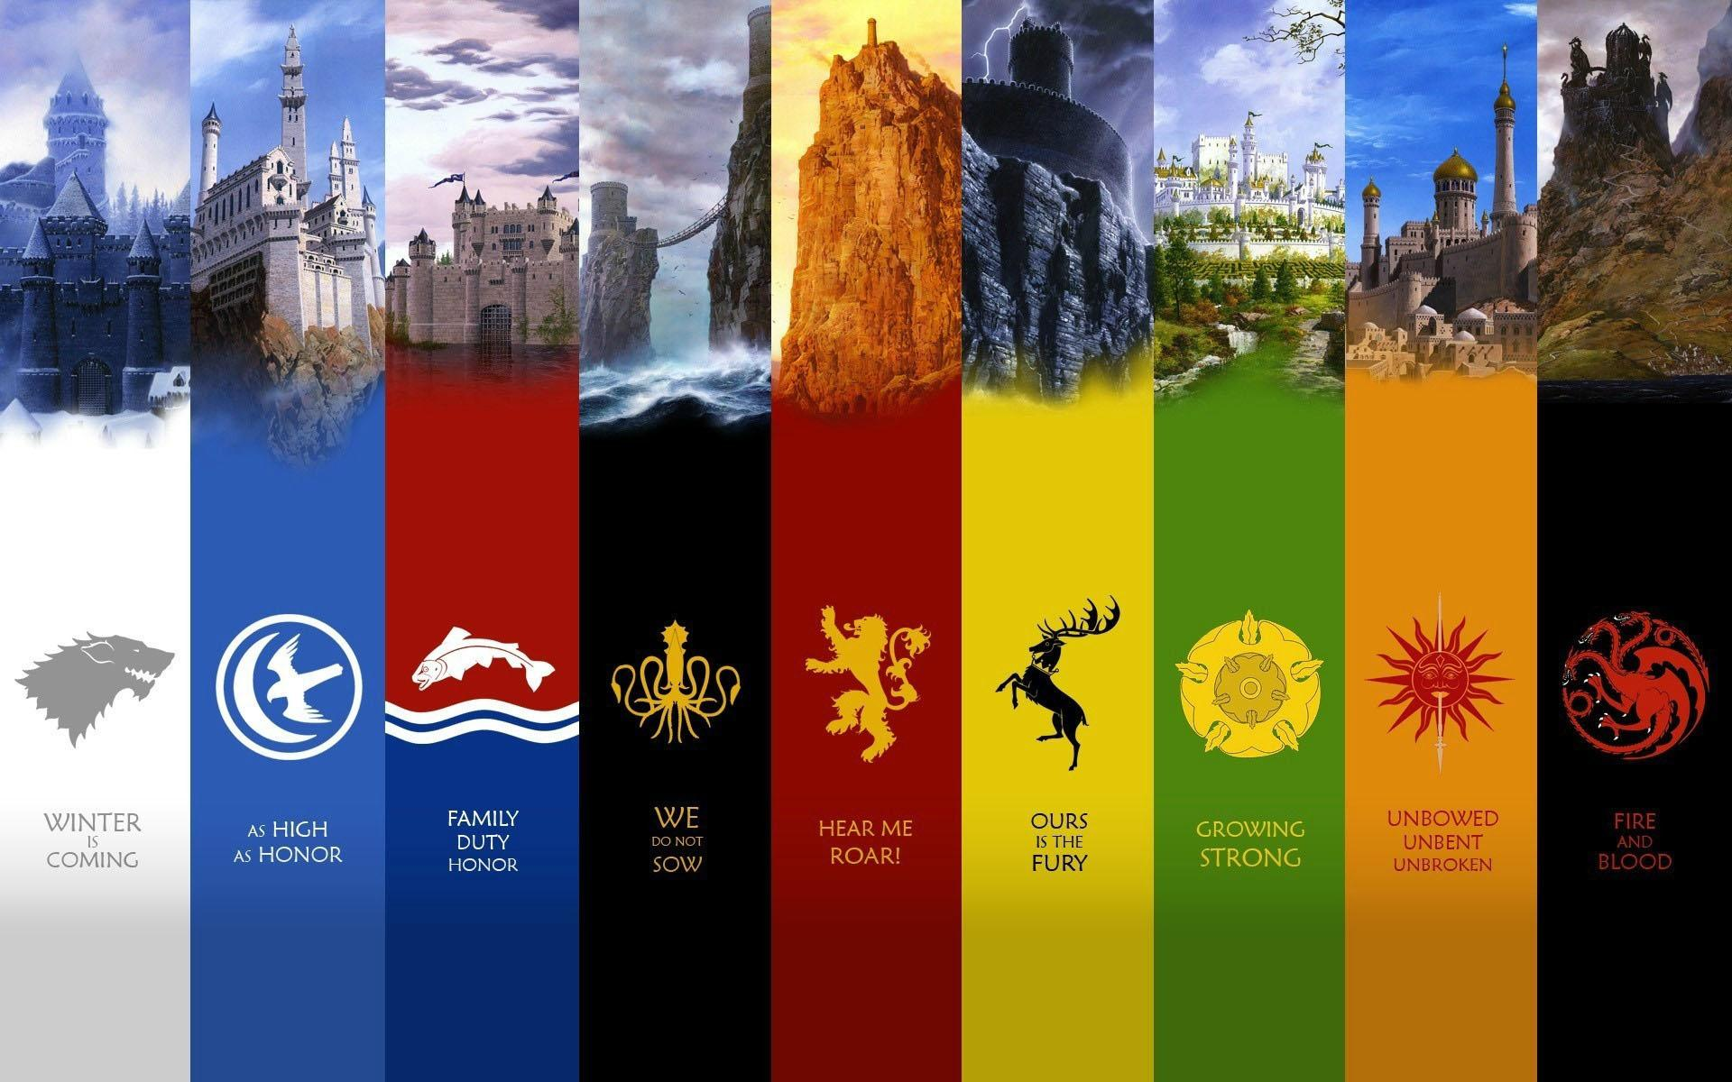
Houses

Slide 5
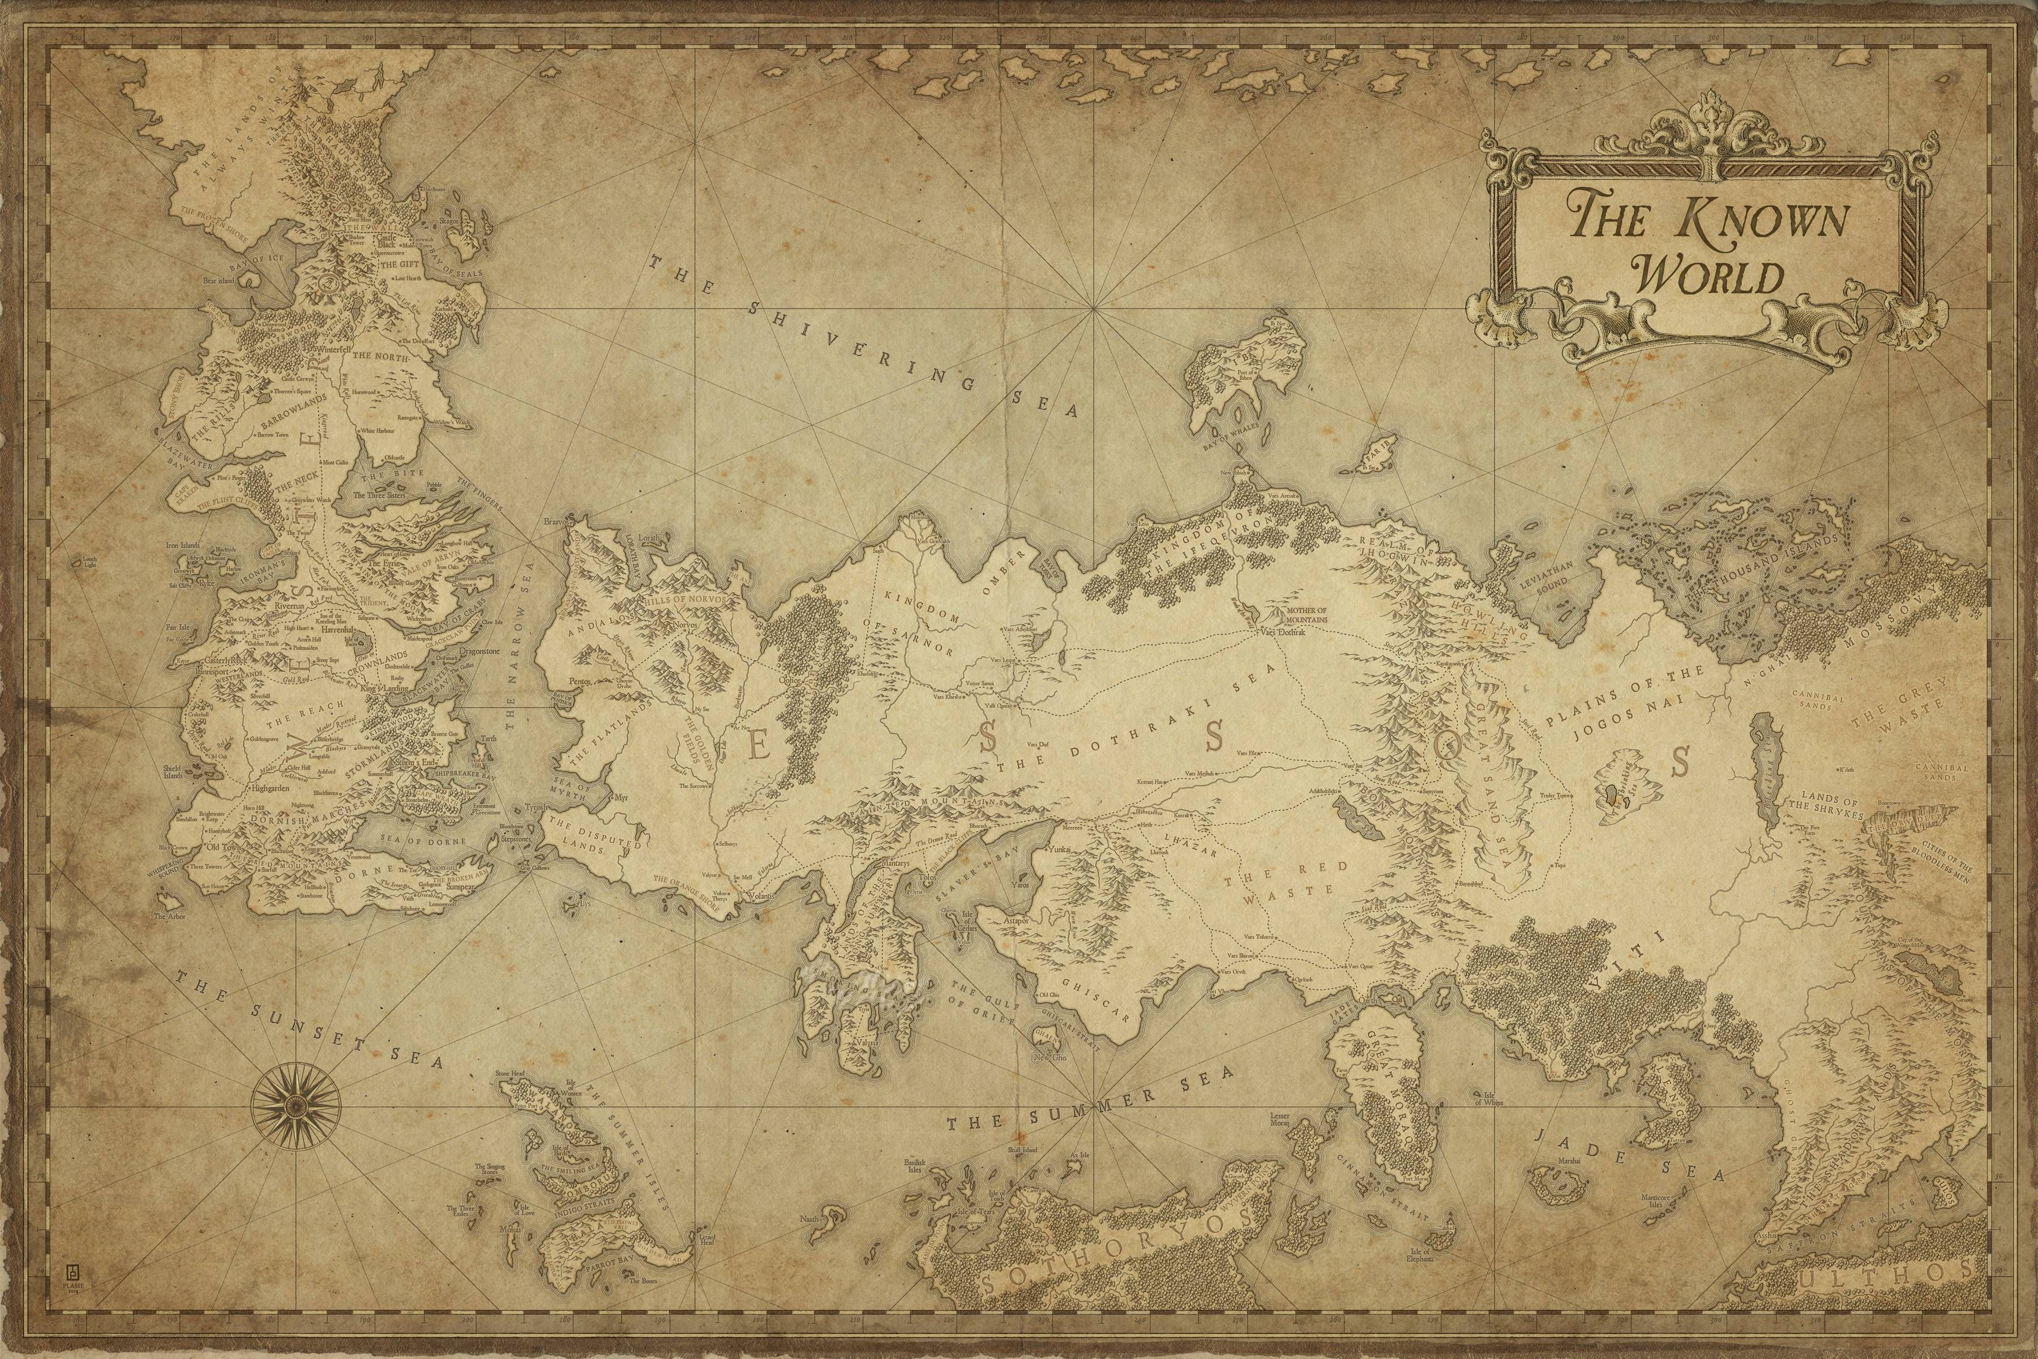

Continents
Westeros
Essos
Sothoryos
Ulthos

Slide 6

API procedures
Mysql DB
GoT API
Load characters from
External API
Mysql DB
Continent
validation
External API

Slide 7
Requests

Slide 8
To characters
Mapping: /characters
GET
GETByName
POST
DELETE

Slide 9
To deads
Mapping: /deads
GET
GETDeadsPerFamily
POST

Slide 10





Tools
IntelliJ
Swagger

